Slide 1

AI and the Environment 5:
Neural Networks: how do they work?

Slide 2
Neural Networks
So we have covered the basic principles of neural networks and a few types of them.
But how do they actually do what they do?
How do they learn?

Slide 3
Neural Networks
We have covered almost all the concepts we need already:
Weights
Biases
Matrix Multiplication
Hyperparameters
Error
Backpropogation
New – Activation functions

Slide 4
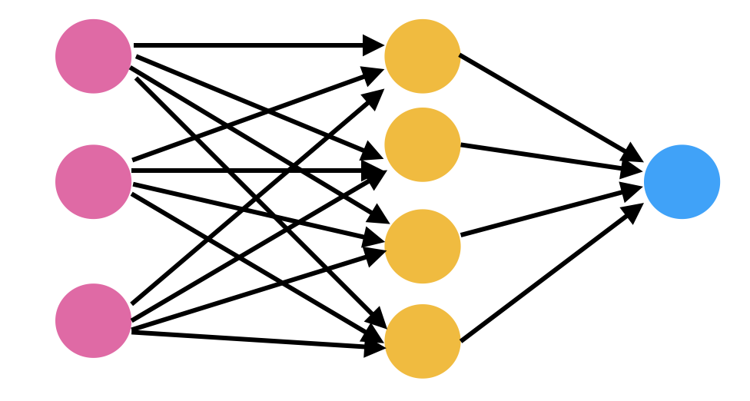
Neural Networks
So from the beginning: Here is a neural network

Slide 5
Neural Networks
I want to use this network to predict whether an area will experience deforestation.

Slide 6
Neural Networks
I have three input features: Distance to deforestation, distance to roads and number of high value tree species.

Slide 7
Neural Networks
I have three input features: Distance to deforestation, distance to roads and number of high value tree species.
10km
1km
4

Slide 8
Neural Networks
The three input features each correspond to an input layer neuron.
10km
1km
4

Slide 9
Neural Networks
The three input features each correspond to an input layer neuron.
10km
1km
4
Input Layer

Slide 10
Neural Networks
The second layer here is called the hidden layer.
10km
1km
4
Hidden Layer

Slide 11
Neural Networks
We could have multiple hidden layers or have a much larger hidden layer.
10km
1km
4
Hidden Layer

Slide 12
Neural Networks
The number and size of the hidden layer is a hyper parameter determined by the designer of the network.
10km
1km
4
Hidden Layer

Slide 13
Neural Networks
The final layer is the output layer.
10km
1km
4
Output Layer

Slide 14
Neural Networks
The output layer size is determined by the number of predictions or classifications you want to make.
10km
1km
4
Output Layer

Slide 15
Neural Networks
In this case we are making a single prediction on whether there will be deforestation or not. So the size is 1.
10km
1km
4
Output Layer

Slide 16
Neural Networks
So what do we do with our input data once it is put into the network?
10km
1km
4

Slide 17
Neural Networks
Every neuron in our hidden layer needs to be triggered by all the input neurons.
10km
1km
4

Slide 18
Neural Networks
To change the dimensionality of a matrix in a way that creates a new matrix of a specified size requires a specific matrix multiplication.
10km
1km
4

Slide 19
Neural Networks
The values we multiply our input neurons by are the weights. These are the values than learn.
10km
1km
4

Slide 20
Neural Networks
In this figure every line is a weight and every dot is a neuron.
So how many weights are there between the input and the hidden layer?
10km
1km
4

Slide 21
Neural Networks
So how many weights are there between the input and the hidden layer?
10km
1km
4
12

Slide 22
Neural Networks
OK so we have 3 input numbers and 12 weights to multiply them by to get the next layers values.
10km
1km
4
12

Slide 23
Neural Networks
The weights are what learn but we still need to set them to a starting value.
Any suggestions?
10km
1km
4
12

Slide 24
Neural Networks
Well there isn’t really a best way but generally speaking you want a distribution between two numbers close to zero on either side of zero i.e -1 to +1
10km
1km
4
12

Slide 25
Neural Networks
For easy maths this time we will just use 0.1 to start
10km
0.1
0.1
0.1
0.1
0.1
1km
0.1
0.1
0.1
0.1
0.1
0.1
4
0.1

Slide 26
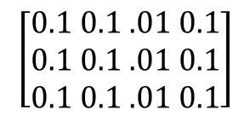

Neural Networks
For easy maths this time we will just use 0.1 to start
$$\left[\begin{aligned}0.1 0.1 .01 0.1 \\ 0.1 0.1 .01 0.1 \\ 0.1 0.1 .01 0.1\end{aligned}\right]$$
$\left[\begin{matrix}10 & 1 & 4\end{matrix}\right]$ X
10km
0.1
0.1
0.1
0.1
0.1
1km
0.1
0.1
0.1
0.1
0.1
0.1
4
0.1

Slide 27

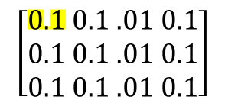

Neural Networks
For easy maths this time we will just use 0.1 to start
$$\left[\begin{aligned}0.1 0.1 .01 0.1 \\ 0.1 0.1 .01 0.1 \\ 0.1 0.1 .01 0.1\end{aligned}\right]$$
$\left[\begin{matrix}10 & 1 & 4\end{matrix}\right]$ X
10km
0.1
0.1
$$\left[1\right]$$
0.1
0.1
0.1
1km
0.1
0.1
0.1
0.1
0.1
0.1
4
0.1

Slide 28

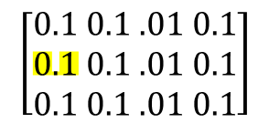

Neural Networks
For easy maths this time we will just use 0.1 to start
$$\left[\begin{aligned}0.1 0.1 .01 0.1 \\ 0.1 0.1 .01 0.1 \\ 0.1 0.1 .01 0.1\end{aligned}\right]$$
$\left[\begin{matrix}10 & 1 & 4\end{matrix}\right]$ X
10km
0.1
0.1
$$\left[\begin{aligned}1 \\ 0.1\end{aligned}\right]$$
0.1
0.1
0.1
1km
0.1
0.1
0.1
0.1
0.1
0.1
4
0.1

Slide 29
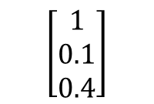
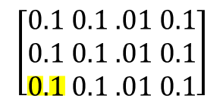

Neural Networks
For easy maths this time we will just use 0.1 to start
$$\left[\begin{aligned}0.1 0.1 .01 0.1 \\ 0.1 0.1 .01 0.1 \\ 0.1 0.1 .01 0.1\end{aligned}\right]$$
$\left[\begin{matrix}10 & 1 & 4\end{matrix}\right]$ X
10km
0.1
0.1
$$\left[\begin{aligned}1 \\ 0.1 \\ 0.4\end{aligned}\right]$$
0.1
0.1
0.1
1km
0.1
0.1
0.1
0.1
0.1
0.1
4
0.1

Slide 30
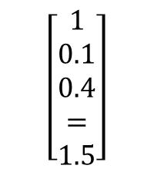
Neural Networks
For easy maths this time we will just use 0.1 to start
$$\left[\begin{aligned}0.1 0.1 .01 0.1 \\ 0.1 0.1 .01 0.1 \\ 0.1 0.1 .01 0.1\end{aligned}\right]$$
$\left[\begin{matrix}10 & 1 & 4\end{matrix}\right]$ X
10km
0.1
0.1
$$\left[\begin{aligned}1 \\ 0.1 \\ 0.4 \\ = \\ 1.5\end{aligned}\right]$$
0.1
0.1
0.1
1km
0.1
0.1
0.1
0.1
0.1
0.1
4
0.1

Slide 31

Neural Networks
For easy maths this time we will just use 0.1 to start
$$\left[\begin{aligned}0.1 0.1 .01 0.1 \\ 0.1 0.1 .01 0.1 \\ 0.1 0.1 .01 0.1\end{aligned}\right]$$
$\left[\begin{matrix}10 & 1 & 4\end{matrix}\right]$ X
10km
0.1
0.1
$$\left[1.5 1.5 1.5 1.5\right]$$
0.1
0.1
0.1
1km
0.1
0.1
0.1
0.1
0.1
0.1
4
0.1

Slide 32
Neural Networks
For easy maths this time we will just use 0.1 to start
$$\left[\begin{aligned}0.1 0.1 .01 0.1 \\ 0.1 0.1 .01 0.1 \\ 0.1 0.1 .01 0.1\end{aligned}\right]$$
$\left[\begin{matrix}10 & 1 & 4\end{matrix}\right]$ X
10km
0.1
1.5
0.1
$$\left[1.5 1.5 1.5 1.5\right]$$
0.1
0.1
0.1
1.5
1km
0.1
0.1
0.1
0.1
1.5
0.1
0.1
4
0.1
1.5

Slide 33
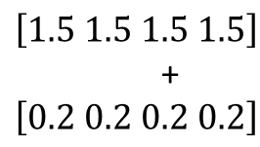
Neural Networks
Each layer will also generally have biases. One per neuron. These can also learn.
Lets make the biases 0.2
$$\left[\begin{aligned}0.1 0.1 .01 0.1 \\ 0.1 0.1 .01 0.1 \\ 0.1 0.1 .01 0.1\end{aligned}\right]$$
$\left[\begin{matrix}10 & 1 & 4\end{matrix}\right]$ X
10km
0.1
0.2
1.5
0.1
$$\left[1.5 1.5 1.5 1.5\right]$$
+
$$\left[0.2 0.2 0.2 0.2\right]$$
0.1
0.1
0.1
0.2
1.5
1km
0.1
0.1
0.1
0.1
0.2
1.5
0.1
0.1
4
0.1
0.2
1.5

Slide 34
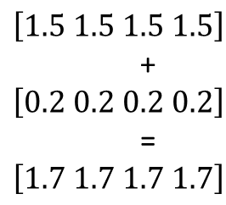
Neural Networks
Each layer will also generally have biases. One per neuron. These can also learn.
Lets make the biases 0.2
$$\left[\begin{aligned}0.1 0.1 .01 0.1 \\ 0.1 0.1 .01 0.1 \\ 0.1 0.1 .01 0.1\end{aligned}\right]$$
$\left[\begin{matrix}10 & 1 & 4\end{matrix}\right]$ X
10km
0.1
0.2
1.7
0.1
$$\left[1.5 1.5 1.5 1.5\right]$$
+
$$\left[0.2 0.2 0.2 0.2\right]$$
=
$$\left[1.7 1.7 1.7 1.7\right]$$
0.1
0.1
0.1
0.2
1.7
1km
0.1
0.1
0.1
0.1
0.2
1.7
0.1
0.1
4
0.1
0.2
1.7

Slide 35
Neural Networks
Now we need to use an activation function on our layer. There are many different activation functions and generally these force our neurons to be between a distribution.
10km
0.1
0.2
1.7
0.1
0.1
0.1
0.1
0.2
1.7
1km
0.1
0.1
0.1
0.1
0.2
1.7
0.1
0.1
4
0.1
0.2
1.7

Slide 36
Neural Networks
Activations functions are what they say on the tin, they basically change the output to decide if the neuron is activated. Imagine firing or not firing in the brain.
10km
0.1
0.2
1.7
0.1
0.1
0.1
0.1
0.2
1.7
1km
0.1
0.1
0.1
0.1
0.2
1.7
0.1
0.1
4
0.1
0.2
1.7

Slide 37
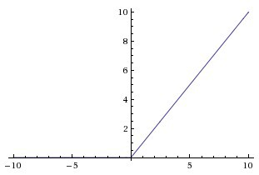

Neural Networks
Lets look at the ReLu function, what this does is effectively turn any negative number into 0 this stops certain neurons from activating.
10km
0.1
0.2
1.7
0.1
0.1
0.1
0.1
0.2
1.7
1km
0.1
0.1
0.1
0.1
0.2
1.7
$$ReLu(x)=max⁡(0,x)$$
0.1
0.1
4
0.1
0.2
1.7

Slide 38
Neural Networks
For what we have so far the ReLu function actually doesn’t do anything, meaning all our neurons fire.
10km
0.1
0.2
1.7
0.1
0.1
0.1
0.1
0.2
1.7
1km
0.1
0.1
0.1
0.1
0.2
1.7
$$ReLu(x)=max⁡(0,x)$$
0.1
0.1
4
0.1
0.2
1.7

Slide 39
Neural Networks
Other functions allow negative neurons to exist and activate. This means that negative values change the output but it is valuable information.
10km
0.1
0.2
1.7
0.1
0.1
0.1
0.1
0.2
1.7
1km
0.1
0.1
0.1
0.1
0.2
1.7
$$ReLu(x)=max⁡(0,x)$$
0.1
0.1
4
0.1
0.2
1.7

Slide 40
Neural Networks
An activation function that doesn’t bring neurons to zero creates a dense network, these can perform better but are more computationally intensive.
10km
0.1
0.2
1.7
0.1
0.1
0.1
0.1
0.2
1.7
1km
0.1
0.1
0.1
0.1
0.2
1.7
$$ReLu(x)=max⁡(0,x)$$
0.1
0.1
4
0.1
0.2
1.7

Slide 41
Neural Networks
Lets use an activation function that will actually change something for us.
Tanh
10km
0.1
0.2
1.7
0.1
0.1
0.1
0.1
0.2
1.7
1km
0.1
0.1
0.1
0.1
0.2
1.7
0.1
0.1
4
0.1
0.2
1.7

Slide 42
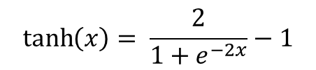
Neural Networks
Lets use an activation function that will actually change something for us.
Tanh
10km
0.1
0.2
1.7
0.1
0.1
0.1
0.1
0.2
1.7
1km
0.1
0.1
0.1
0.1
0.2
1.7
0.1
$$\tanh\left(x\right)= \frac{2}{{1+e}^{−2x}}−1$$
0.1
4
0.1
0.2
1.7

Slide 43
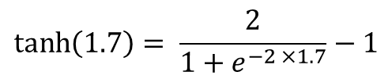
Neural Networks
Lets use an activation function that will actually change something for us.
Tanh
10km
0.1
0.2
1.7
0.1
0.1
0.1
0.1
0.2
1.7
1km
0.1
0.1
0.1
0.1
0.2
1.7
0.1
$$\tanh\left(1.7\right)= \frac{2}{{1+e}^{−2 ×1.7}}−1$$
0.1
4
0.1
0.2
1.7

Slide 44

Neural Networks
Lets use an activation function that will actually change something for us.
Tanh
10km
0.1
0.2
1.7
0.1
0.1
0.1
0.1
0.2
1.7
1km
0.1
0.1
0.1
0.1
0.2
1.7
0.1
$$\tanh\left(1.7\right)=0.9354$$
0.1
4
0.1
0.2
1.7

Slide 45
Neural Networks
Lets use an activation function that will actually change something for us.
Tanh
10km
0.1
0.2
0.9354
0.1
0.1
0.1
0.1
0.2
0.9354
1km
0.1
0.1
0.1
0.1
0.2
0.9354
0.1
$$\tanh\left(1.7\right)=0.9354$$
0.1
4
0.1
0.2
0.9354

Slide 46
Neural Networks
Ok so now we have our second layer outputs guess what?
10km
0.1
0.2
0.9354
0.1
0.1
0.1
0.1
0.2
0.9354
1km
0.1
0.1
0.1
0.1
0.2
0.9354
0.1
0.1
4
0.1
0.2
0.9354

Slide 47
Neural Networks
The final weights – of which we have 4. Lets make these weights [0.1 0.2 0.3 0.4]
10km
0.1
0.2
0.9354
0.1
0.1
0.1
0.1
0.1
0.2
0.9354
0.2
1km
0.1
0.1
0.3
0.1
0.1
0.2
0.9354
0.1
0.1
0.4
4
0.1
0.2
0.9354

Slide 48
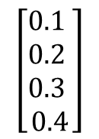

Neural Networks
The final weights – of which we have 4. Lets make these weights [0.1 0.2 0.3 0.4]
$\left[\begin{matrix}0.9345 & 0.9345 & 0.9345 0.9345\end{matrix}\right]$ X
$$\left[\begin{aligned}0.1 \\ 0.2 \\ 0.3 \\ 0.4\end{aligned}\right]$$
10km
0.1
0.2
0.9354
0.1
0.1
0.1
0.1
0.1
0.2
0.9354
0.2
1km
0.1
0.1
0.3
0.1
0.1
0.2
0.9354
0.1
0.1
0.4
4
0.1
0.2
0.9354

Slide 49
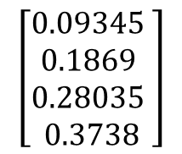
Neural Networks
The final weights – of which we have 4. Lets make these weights [0.1 0.2 0.3 0.4]
$\left[\begin{matrix}0.9345 & 0.9345 & 0.9345 0.9345\end{matrix}\right]$ X
$$\left[\begin{aligned}0.1 \\ 0.2 \\ 0.3 \\ 0.4\end{aligned}\right]$$
10km
0.1
0.2
0.9354
0.1
0.1
0.1
0.1
0.1
0.2
0.9354
0.2
1km
0.1
$$\left[\begin{aligned}0.09345 \\ 0.1869 \\ 0.28035 \\ 0.3738\end{aligned}\right]$$
0.1
0.3
0.1
0.1
0.2
0.9354
0.1
0.1
0.4
4
0.1
0.2
0.9354

Slide 50
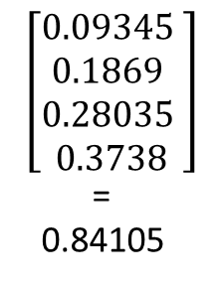
Neural Networks
The final weights – of which we have 4. Lets make these weights [0.1 0.2 0.3 0.4]
$\left[\begin{matrix}0.9345 & 0.9345 & 0.9345 0.9345\end{matrix}\right]$ X
$$\left[\begin{aligned}0.1 \\ 0.2 \\ 0.3 \\ 0.4\end{aligned}\right]$$
10km
0.1
0.2
0.9354
0.1
0.1
0.1
0.1
0.1
0.2
0.9354
0.2
1km
0.1
$$\left[\begin{aligned}0.09345 \\ 0.1869 \\ 0.28035 \\ 0.3738\end{aligned}\right]$$
=
0.84105
0.1
0.3
0.1
0.1
0.2
0.9354
0.1
0.1
0.4
4
0.1
0.2
0.9354

Slide 51
Neural Networks
The last thing we need to do is apply our bias lets say -0.1 for this bias
10km
0.1
0.2
0.9354
0.1
0.1
0.1
0.1
0.1
0.2
0.9354
0.2
1km
0.1
0.84105
0.1
0.3
0.1
0.1
0.2
0.9354
0.1
0.1
0.4
4
0.1
0.2
0.9354

Slide 52
Neural Networks
The last thing we need to do is apply our bias lets say -0.1 for this bias
10km
0.1
0.2
0.9354
0.1
0.1
0.1
0.1
0.1
0.2
0.9354
0.2
1km
0.1
-0.1
0.74105
0.1
0.3
0.1
0.1
0.2
0.9354
0.1
0.1
0.4
4
0.1
0.2
0.9354

Slide 53
Neural Networks
Ok we have the value of the output neuron. The last thing to do is apply our activation function and see if it fires i.e if this area is going to be deforested?
10km
0.1
0.2
0.9354
0.1
0.1
0.1
0.1
0.1
0.2
0.9354
0.2
1km
0.1
-0.1
0.74105
0.1
0.3
0.1
0.1
0.2
0.9354
0.1
0.1
0.4
4
0.1
0.2
0.9354

Slide 54
Neural Networks
Ok we have the value of the output neuron. The last thing to do is apply our activation function and see if it fires i.e if this area is going to be deforested?
10km
0.1
0.2
0.9354
0.1
0.1
0.1
0.1
0.1
0.2
0.9354
0.2
1km
0.1
-0.1
0.74105
0.1
0.3
0.1
0.1
0.2
0.9354
0.1
0.1
0.4
4
0.1
0.2
0.9354

Slide 55
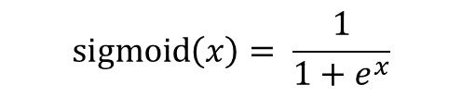
Neural Networks
For this final binary output we will use the sigmoid function:
10km
0.1
0.2
0.9354
0.1
0.1
0.1
0.1
0.1
0.2
0.9354
0.2
1km
0.1
-0.1
0.74105
0.1
0.3
0.1
0.1
0.2
0.9354
0.1
$$\operatorname{sigmoid}\left(x\right)= \frac{1}{{1+e}^{x}}$$
0.1
0.4
4
0.1
0.2
0.9354

Slide 56
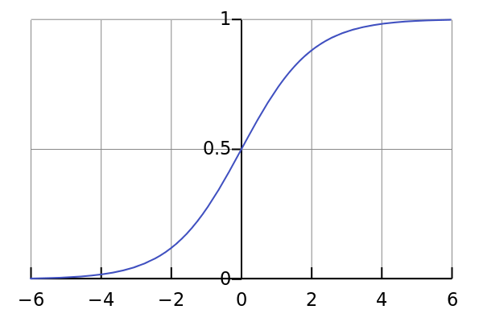
Neural Networks
For this final binary output we will use the sigmoid function:
10km
0.1
0.2
0.9354
0.1
0.1
0.1
0.1
0.1
0.2
0.9354
0.2
1km
0.1
-0.1
0.74105
0.1
0.3
0.1
0.1
0.2
0.9354
0.1
$$\operatorname{sigmoid}\left(x\right)= \frac{1}{{1+e}^{x}}$$
0.1
0.4
4
0.1
0.2
0.9354

Slide 57
Neural Networks
Sigmoid is a nice binary classifier which restricts it between 0 and 1, positive values will activate the neuron to values above 0.5
10km
0.1
0.2
0.9354
0.1
0.1
0.1
0.1
0.1
0.2
0.9354
0.2
1km
0.1
-0.1
0.74105
0.1
0.3
0.1
0.1
0.2
0.9354
0.1
$$\operatorname{sigmoid}\left(x\right)= \frac{1}{{1+e}^{x}}$$
0.1
0.4
4
0.1
0.2
0.9354

Slide 58

Neural Networks
Sigmoid is a nice binary classifier which restricts it between 0 and 1, positive values will activate the neuron to values above 0.5
10km
0.1
0.2
0.9354
0.1
0.1
0.1
0.1
0.1
0.2
0.9354
0.2
1km
0.1
-0.1
0.74105
0.1
0.3
0.1
0.1
0.2
0.9354
0.1
0.1
0.4
$$\operatorname{sigmoid}\left(0.74105\right)=0.6772$$
4
0.1
0.2
0.9354

Slide 59

Neural Networks
Sigmoid is a nice binary classifier which restricts it between 0 and 1, positive values will activate the neuron to values above 0.5
10km
0.1
0.2
0.9354
0.1
0.1
0.1
0.1
0.1
0.2
0.9354
0.2
1km
0.1
-0.1
0.6772
0.1
0.3
0.1
0.1
0.2
0.9354
0.1
0.1
0.4
$$\operatorname{sigmoid}\left(0.84105\right)=0.6772$$
4
0.1
0.2
0.9354

Slide 60
Neural Networks
What we have done here is one full forward pass of our neural network and we have an output.
10km
0.1
0.2
0.9354
0.1
0.1
0.1
0.1
0.1
0.2
0.9354
0.2
1km
0.1
-0.1
0.6772
0.1
0.3
0.1
0.1
0.2
0.9354
0.1
0.1
0.4
4
0.1
0.2
0.9354

Slide 61
Neural Networks
We can think of the output as a probability or certainty of our predicted output.
Here we are saying there is a 0.69 probability or % chance that this area will be deforested.
10km
0.1
0.2
0.9354
0.1
0.1
0.1
0.1
0.1
0.2
0.9354
0.2
1km
0.1
0.69869
0.1
0.3
0.1
0.1
0.2
0.9354
0.1
0.1
0.4
4
0.1
0.2
0.9354

Slide 62
Neural Networks
So we need to tackle the hard part of this. Backpropagation.
10km
0.1
0.2
0.9354
0.1
0.1
0.1
0.1
0.1
0.2
0.9354
0.2
1km
0.1
-0.1
0.6772
0.1
0.3
0.1
0.1
0.2
0.9354
0.1
0.1
0.4
4
0.1
0.2
0.9354

Slide 63
Neural Networks
The first thing we will need is a measure of the error. Lets assume that the area was deforested so we want our NN to give the output 1 with these inputs.
10km
0.1
0.2
0.9354
0.1
0.1
0.1
0.1
0.1
0.2
0.9354
0.2
1km
0.1
-0.1
0.6772
0.1
0.3
0.1
0.1
0.2
0.9354
0.1
0.1
0.4
4
0.1
0.2
0.9354

Slide 64
Neural Networks
We will use a simple error calculation which is best for these classification problems:
Cross entropy also called log loss.
10km
0.1
0.2
0.9354
0.1
0.1
0.1
0.1
0.1
0.2
0.9354
0.2
1km
0.1
-0.1
0.6772
0.1
0.3
0.1
0.1
0.2
0.9354
0.1
0.1
0.4
4
0.1
0.2
0.9354

Slide 65

Neural Networks
We will use a simple error calculation which is best for these classification problems:
Cross entropy also called log loss.
10km
0.1
0.2
0.9354
0.1
0.1
0.1
0.1
0.1
0.2
0.9354
0.2
1km
0.1
-0.1
0.6772
0.1
0.3
0.1
0.1
0.2
0.9354
0.1
0.1
0.4
4
$$xent=\hat{y} ×−log⁡(y)$$
0.1
0.2
0.9354

Slide 66
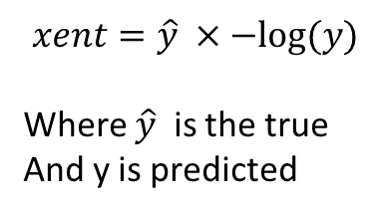
Neural Networks
We will use a simple error calculation which is best for these classification problems:
Cross entropy also called log loss.
10km
0.1
0.2
0.9354
0.1
0.1
0.1
0.1
0.1
0.2
0.9354
0.2
1km
0.1
-0.1
0.6772
0.1
0.3
0.1
0.1
0.2
0.9354
0.1
0.1
0.4
4
$$xent=\hat{y} ×−log⁡(y)$$
Where $\hat{y}$ is the true
And y is predicted
0.1
0.2
0.9354

Slide 67
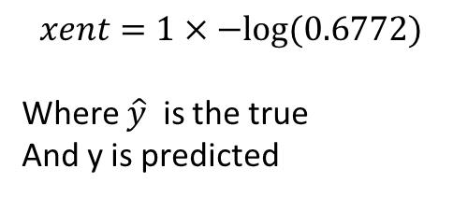
Neural Networks
We will use a simple error calculation which is best for these classification problems:
Cross entropy also called log loss.
10km
0.1
0.2
0.9354
0.1
0.1
0.1
0.1
0.1
0.2
0.9354
0.2
1km
0.1
-0.1
0.6772
0.1
0.3
0.1
0.1
0.2
0.9354
0.1
0.1
0.4
4
$$xent=1×−log⁡(0.6772)$$
Where $\hat{y}$ is the true
And y is predicted
0.1
0.2
0.9354

Slide 68

Neural Networks
We will use a simple error calculation which is best for these classification problems:
Cross entropy also called log loss.
10km
0.1
0.2
0.9354
0.1
0.1
0.1
0.1
0.1
0.2
0.9354
0.2
1km
0.1
-0.1
0.6772
0.1
0.3
0.1
0.1
0.2
0.9354
0.1
0.1
0.4
4
$$xent=−0.1692$$
0.1
0.2
0.9354

Slide 69
Neural Networks
Ok so we have a measure of the error for this prediction, we now have to back propagate this through the network.
10km
0.1
0.2
0.9354
0.1
0.1
0.1
0.1
0.1
0.2
0.9354
0.2
1km
0.1
-0.1
0.6772
0.1
0.3
0.1
0.1
0.2
0.9354
0.1
0.1
0.4
4
$$xent=−0.1692$$
0.1
0.2
0.9354

Slide 70
Neural Networks
Well as before we need the amount to change the weights by which means a rate of change or derivative.
10km
0.1
0.2
0.9354
0.1
0.1
0.1
0.1
0.1
0.2
0.9354
0.2
1km
0.1
-0.1
0.6772
0.1
0.3
0.1
0.1
0.2
0.9354
0.1
0.1
0.4
4
$$xent=−0.1692$$
0.1
0.2
0.9354

Slide 71
Neural Networks
Well as before we need the derivative of the loss function in respect to the weights and biases.
10km
0.1
0.2
0.9354
0.1
0.1
0.1
0.1
0.1
0.2
0.9354
0.2
1km
0.1
-0.1
0.6772
0.1
0.3
0.1
0.1
0.2
0.9354
0.1
0.1
0.4
4
$$xent=−0.1692$$
0.1
0.2
0.9354

Slide 72
Neural Networks
However we have an issue here in that our weights and biases have gone through their own activation function.
10km
0.1
0.2
0.9354
0.1
0.1
0.1
0.1
0.1
0.2
0.9354
0.2
1km
0.1
-0.1
0.6772
0.1
0.3
0.1
0.1
0.2
0.9354
0.1
0.1
0.4
4
$$xent=−0.1692$$
0.1
0.2
0.9354

Slide 73
Neural Networks
Using our old friend the chain rule in differentiation we basically get:
Differential of Loss X Differential of Activation X Output of Previous layer
10km
0.1
0.2
0.9354
0.1
0.1
0.1
0.1
0.1
0.2
0.9354
0.2
1km
0.1
-0.1
0.6772
0.1
0.3
0.1
0.1
0.2
0.9354
0.1
0.1
0.4
4
$$xent=−0.1692$$
0.1
0.2
0.9354

Slide 74
Neural Networks
Differential of Loss X Differential of Activation X Output of Previous Layer
$−\frac{1}{xent} ×(sigmoid\left(x\right)×\left(1 −sigmoid\left(x\right))\right) ×Out2$
10km
0.1
0.2
0.9354
0.1
0.1
0.1
0.1
0.1
0.2
0.9354
0.2
1km
0.1
-0.1
0.6772
0.1
0.3
0.1
0.1
0.2
0.9354
0.1
0.1
0.4
4
$$xent=−0.1692$$
0.1
0.2
0.9354

Slide 75
Neural Networks
$−\frac{1}{xent} ×(sigmoid\left(x\right)×\left(1 −sigmoid\left(x\right))\right) ×[0.9354 0.9354 0.9354 0.9354$]
10km
0.1
0.2
0.9354
0.1
0.1
0.1
0.1
0.1
0.2
0.9354
0.2
1km
0.1
-0.1
0.6772
0.1
0.3
0.1
0.1
0.2
0.9354
0.1
0.1
0.4
4
$$xent=−0.1692$$
0.1
0.2
0.9354

Slide 76
Neural Networks
$−\frac{1}{−0.1692} ×(sigmoid\left(0.6772\right)×\left(1 −sigmoid\left(0.6772\right))\right) ×\left[0.9354 0.9354 0.9354 0.9354\right]$
10km
0.1
0.2
0.9354
0.1
0.1
0.1
0.1
0.1
0.2
0.9354
0.2
1km
0.1
-0.1
0.6772
0.1
0.3
0.1
0.1
0.2
0.9354
0.1
0.1
0.4
4
$$xent=−0.1692$$
0.1
0.2
0.9354

Slide 77
Neural Networks
$−\frac{1}{−0.1692} ×(0.6631×\left(1 −0.6631)\right) ×[0.9354 0.9354 0.9354 0.9354]$
10km
0.1
0.2
0.9354
0.1
0.1
0.1
0.1
0.1
0.2
0.9354
0.2
1km
0.1
-0.1
0.6772
0.1
0.3
0.1
0.1
0.2
0.9354
0.1
0.1
0.4
4
$$xent=−0.1692$$
0.1
0.2
0.9354

Slide 78
Neural Networks
$−\frac{1}{−0.1692} × 0.2234 ×[0.9354 0.9354 0.9354 0.9354]$
10km
0.1
0.2
0.9354
0.1
0.1
0.1
0.1
0.1
0.2
0.9354
0.2
1km
0.1
-0.1
0.6772
0.1
0.3
0.1
0.1
0.2
0.9354
0.1
0.1
0.4
4
$$xent=−0.1692$$
0.1
0.2
0.9354

Slide 79
Neural Networks
$5.1902× 0.2234 ×[0.9354 0.9354 0.9354 0.9354]$
10km
0.1
0.2
0.9354
0.1
0.1
0.1
0.1
0.1
0.2
0.9354
0.2
1km
0.1
-0.1
0.6772
0.1
0.3
0.1
0.1
0.2
0.9354
0.1
0.1
0.4
4
$$xent=−0.1692$$
0.1
0.2
0.9354

Slide 80
Neural Networks
[$1.3203]×[0.9354 0.9354 0.9354 0.9354]$
10km
0.1
0.2
0.9354
0.1
0.1
0.1
0.1
0.1
0.2
0.9354
0.2
1km
0.1
-0.1
0.6772
0.1
0.3
0.1
0.1
0.2
0.9354
0.1
0.1
0.4
4
$$xent=−0.1692$$
0.1
0.2
0.9354

Slide 81
Neural Networks
[$1.3203]×\left[0.9354 0.9354 0.9354 0.9354\right]=[1.235 1.235 1.235 1.235]$
10km
0.1
0.2
0.9354
0.1
0.1
0.1
0.1
0.1
0.2
0.9354
0.2
1km
0.1
-0.1
0.6772
0.1
0.3
0.1
0.1
0.2
0.9354
0.1
0.1
0.4
4
$$xent=−0.1692$$
0.1
0.2
0.9354

Slide 82
Neural Networks
$[1.235 1.235 1.235 1.235]$
10km
0.1
0.2
0.9354
0.1
0.1
0.1
0.1
0.1
0.2
0.9354
0.2
1km
0.1
-0.1
0.6772
0.1
0.3
0.1
0.1
0.2
0.9354
0.1
0.1
0.4
4
$$xent=−0.1692$$
0.1
0.2
0.9354

Slide 83
Neural Networks
$\left[1.235 1.235 1.235 1.235\right]$
How about the biases though?
10km
0.1
0.2
0.9354
0.1
0.1
0.1
0.1
0.1
0.2
0.9354
0.2
1km
0.1
-0.1
0.6772
0.1
0.3
0.1
0.1
0.2
0.9354
0.1
0.1
0.4
4
$$xent=−0.1692$$
0.1
0.2
0.9354

Slide 84
Neural Networks
$\left[1.235 1.235 1.235 1.235\right]$
Generally the rule is that the change in the bias is the sum of the Weights change.
10km
0.1
0.2
0.9354
0.1
0.1
0.1
0.1
0.1
0.2
0.9354
0.2
1km
0.1
-0.1
0.6772
0.1
0.3
0.1
0.1
0.2
0.9354
0.1
0.1
0.4
4
$$xent=−0.1692$$
0.1
0.2
0.9354

Slide 85

Neural Networks
$\left[1.235 1.235 1.235 1.235\right]$
$bias= \sum{\left[1.235 1.235 1.235 1.235\right]}$
10km
0.1
0.2
0.9354
0.1
0.1
0.1
0.1
0.1
0.2
0.9354
0.2
1km
0.1
-0.1
0.6772
0.1
0.3
0.1
0.1
0.2
0.9354
0.1
0.1
0.4
4
$$xent=−0.1692$$
0.1
0.2
0.9354

Slide 86
Neural Networks
$\left[1.235 1.235 1.235 1.235\right]$
$bias=4.940$
10km
0.1
0.2
0.9354
0.1
0.1
0.1
0.1
0.1
0.2
0.9354
0.2
1km
0.1
-0.1
0.6772
0.1
0.3
0.1
0.1
0.2
0.9354
0.1
0.1
0.4
4
$$xent=−0.1692$$
0.1
0.2
0.9354

Slide 87
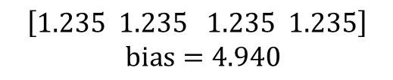
Neural Networks
It is important to remember that these are in fact the changes in the weights / bias not the actual new values.
$$\left[1.235 1.235 1.235 1.235\right]$$
$bias=4.940$
10km
0.1
0.2
0.9354
0.1
0.1
0.1
0.1
0.1
0.2
0.9354
0.2
1km
0.1
-0.1
0.6772
0.1
0.3
0.1
0.1
0.2
0.9354
0.1
0.1
0.4
4
$$xent=−0.1692$$
0.1
0.2
0.9354

Slide 88
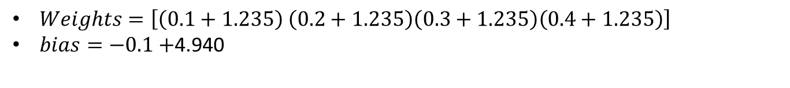
Neural Networks
$Weights=\left[\left(0.1+1.235\right) \left(0.2+1.235\right)\left(0.3+1.235\right)\left(0.4+1.235\right)\right]$
$bias=−0.1+$4.940
$$\left[1.235 1.235 1.235 1.235\right]$$
$bias=4.940$
10km
0.1
0.2
0.9354
0.1
0.1
0.1
0.1
0.1
0.2
0.9354
0.2
1km
0.1
-0.1
0.6772
0.1
0.3
0.1
0.1
0.2
0.9354
0.1
0.1
0.4
4
$$xent=−0.1692$$
0.1
0.2
0.9354

Slide 89
Neural Networks
$Weights=\left[1.335 1.435 1.535 1.635\right]$
$bias=4.840$
$$\left[1.235 1.235 1.235 1.235\right]$$
$bias=4.940$
10km
0.1
0.2
0.9354
0.1
0.1
0.1
0.1
0.1
0.2
0.9354
0.2
1km
0.1
-0.1
0.6772
0.1
0.3
0.1
0.1
0.2
0.9354
0.1
0.1
0.4
4
$$xent=−0.1692$$
0.1
0.2
0.9354

Slide 90
Neural Networks
$Weights=\left[1.335 1.435 1.535 1.635\right]$
$bias=4.840$
$$\left[1.235 1.235 1.235 1.235\right]$$
$bias=4.940$
10km
0.1
0.2
0.9354
0.1
1.335
0.1
0.1
0.1
0.2
0.9354
1.435
1km
0.1
4.840
0.6772
0.1
1.535
0.1
0.1
0.2
0.9354
0.1
0.1
1.635
4
$$xent=−0.1692$$
0.1
0.2
0.9354

Slide 91
Neural Networks
Ok now we have updated our first layer (or in reality the second layer) of weights we need to keep the back propagation going.
10km
0.1
0.2
0.9354
0.1
1.335
0.1
0.1
0.1
0.2
0.9354
1.435
1km
0.1
4.840
0.6772
0.1
1.535
0.1
0.1
0.2
0.9354
0.1
0.1
1.635
4
$$xent=−0.1692$$
0.1
0.2
0.9354

Slide 92
Neural Networks
The formula for the next layer is a bit more complicated:
10km
0.1
0.2
0.9354
0.1
1.335
0.1
0.1
0.1
0.2
0.9354
1.435
1km
0.1
4.840
0.6772
0.1
1.535
0.1
0.1
0.2
0.9354
0.1
0.1
1.635
4
$$xent=−0.1692$$
0.1
0.2
0.9354

Slide 93
Neural Networks
$$(\left(\left(Error Differential ×Activation Function Differential of output\right)×Weights of second layer\right) ×Activation differential of curent layer) ×Output of previous layer(i.e input)$$
10km
0.1
0.2
0.9354
0.1
1.335
0.1
0.1
0.1
0.2
0.9354
1.435
1km
0.1
4.840
0.6772
0.1
1.535
0.1
0.1
0.2
0.9354
0.1
0.1
1.635
4
$$xent=−0.1692$$
0.1
0.2
0.9354

Slide 94
Neural Networks
$$(\left(\left(Error Differential ×Activation Function Differential of output\right)×Weights of second layer\right) ×Activation differential of curent layer) ×Output of previous layer(i.e input)$$
10km
0.1
0.2
0.9354
All a bit complicated so lets break it down bit by bit
0.1
1.335
0.1
0.1
0.1
0.2
0.9354
1.435
1km
0.1
4.840
0.6772
0.1
1.535
0.1
0.1
0.2
0.9354
0.1
0.1
1.635
4
$$xent=−0.1692$$
0.1
0.2
0.9354

Slide 95
Neural Networks
$$(\left(\left(Error Differential ×Activation Function Differential of output\right)×Weights of second layer\right) ×Activation differential of curent layer) ×Output of previous layer(i.e input)$$
10km
0.1
0.2
0.9354
This first bit we used at the start this is our error differential and is maintained all the way through.
0.1
1.335
0.1
0.1
0.1
0.2
0.9354
1.435
1km
0.1
4.840
0.6772
0.1
1.535
0.1
0.1
0.2
0.9354
0.1
0.1
1.635
4
$$xent=−0.1692$$
0.1
0.2
0.9354

Slide 96
Neural Networks
$$(\left(1.3203×Weights of second layer\right) ×Activation differential of curent layer) ×Output of previous layer(i.e input)$$
10km
0.1
0.2
0.9354
This first bit we used at the start this is our error differential and is maintained all the way through.
0.1
1.335
0.1
0.1
0.1
0.2
0.9354
1.435
1km
0.1
4.840
0.6772
0.1
1.535
0.1
0.1
0.2
0.9354
0.1
0.1
1.635
4
$$xent=−0.1692$$
0.1
0.2
0.9354

Slide 97
Neural Networks
$$(\left(1.3203×Weights of second layer\right) ×Activation differential of curent layer) ×Output of previous layer(i.e input)$$
10km
0.1
0.2
0.9354
Here we multiply that by the weights of the layer and it is important to note it is the original weights that we used not the updated.
0.1
1.335
0.1
0.1
0.1
0.2
0.9354
1.435
1km
0.1
4.840
0.6772
0.1
1.535
0.1
0.1
0.2
0.9354
0.1
0.1
1.635
4
$$xent=−0.1692$$
0.1
0.2
0.9354

Slide 98
Neural Networks
$$(\left(1.3203×[0.1 0.2 0.3 0.4]\right) ×Activation differential of curent layer) ×Output of previous layer(i.e input)$$
10km
0.1
0.2
0.9354
Here we multiply that by the weights of the layer and it is important to note it is the original weights that we used not the updated.
0.1
1.335
0.1
0.1
0.1
0.2
0.9354
1.435
1km
0.1
4.840
0.6772
0.1
1.535
0.1
0.1
0.2
0.9354
0.1
0.1
1.635
4
$$xent=−0.1692$$
0.1
0.2
0.9354

Slide 99
Neural Networks
$$(\left([0.13203 0.26406 0.39609 0.52812]\right) ×Activation differential of curent layer) ×Output of previous layer(i.e input)$$
10km
0.1
0.2
0.9354
Here we multiply that by the weights of the layer and it is important to note it is the original weights that we used not the updated.
0.1
1.335
0.1
0.1
0.1
0.2
0.9354
1.435
1km
0.1
4.840
0.6772
0.1
1.535
0.1
0.1
0.2
0.9354
0.1
0.1
1.635
4
$$xent=−0.1692$$
0.1
0.2
0.9354

Slide 100
Neural Networks
$$(\left([0.13203 0.26406 0.39609 0.52812]\right) ×Activation differential of curent layer) ×Output of previous layer(i.e input)$$
10km
0.1
0.2
0.9354
Ok now we have that we need the differential of tanh.
0.1
1.335
0.1
0.1
0.1
0.2
0.9354
1.435
1km
0.1
4.840
0.6772
0.1
1.535
0.1
0.1
0.2
0.9354
0.1
0.1
1.635
4
$$xent=−0.1692$$
0.1
0.2
0.9354

Slide 101
Neural Networks
$$(\left(\left[0.13203 0.26406 0.39609 0.52812\right]\right) ×\tanh{differential}(x)) ×Output of previous layer(i.e input)$$
10km
0.1
0.2
0.9354
Ok now we have that we need the differential of tanh.
0.1
1.335
0.1
0.1
0.1
0.2
0.9354
1.435
1km
0.1
4.840
0.6772
0.1
1.535
0.1
0.1
0.2
0.9354
0.1
0.1
1.635
4
$$xent=−0.1692$$
0.1
0.2
0.9354

Slide 102
Neural Networks
$$(\left(\left[0.13203 0.26406 0.39609 0.52812\right]\right) ×1 −\tanh^{2}{(x)}) ×Output of previous layer(i.e input)$$
10km
0.1
0.2
0.9354
Ok now we have that we need the differential of tanh.
0.1
1.335
0.1
0.1
0.1
0.2
0.9354
1.435
1km
0.1
4.840
0.6772
0.1
1.535
0.1
0.1
0.2
0.9354
0.1
0.1
1.635
4
$$xent=−0.1692$$
0.1
0.2
0.9354

Slide 103
Neural Networks
$$(\left(\left[0.13203 0.26406 0.39609 0.52812\right]\right) ×1 −\tanh^{2}{(x)}) ×Output of previous layer(i.e input)$$
10km
0.1
0.2
0.9354
We need to apply our differential of tanh to all the outputs of this layer.
0.1
1.335
0.1
0.1
0.1
0.2
0.9354
1.435
1km
0.1
4.840
0.6772
0.1
1.535
0.1
0.1
0.2
0.9354
0.1
0.1
1.635
4
$$xent=−0.1692$$
0.1
0.2
0.9354

Slide 104
Neural Networks
$$(\left(\left[0.13203 0.26406 0.39609 0.52812\right]\right) ×1 −\tanh^{2}{([0.9354 0.9354 0.9354 0.9354)}) ×Output of previous layer(i.e input)$$
10km
0.1
0.2
0.9354
We need to apply our differential of tanh to all the outputs of this layer.
0.1
1.335
0.1
0.1
0.1
0.2
0.9354
1.435
1km
0.1
4.840
0.6772
0.1
1.535
0.1
0.1
0.2
0.9354
0.1
0.1
1.635
4
$$xent=−0.1692$$
0.1
0.2
0.9354

Slide 105
Neural Networks
$$(\left(\left[0.13203 0.26406 0.39609 0.52812\right]\right) ×[0.4626 0.4626 0.4626 0.4626]) ×Output of previous layer(i.e input)$$
10km
0.1
0.2
0.9354
We need to apply our differential of tanh to all the outputs of this layer.
0.1
1.335
0.1
0.1
0.1
0.2
0.9354
1.435
1km
0.1
4.840
0.6772
0.1
1.535
0.1
0.1
0.2
0.9354
0.1
0.1
1.635
4
$$xent=−0.1692$$
0.1
0.2
0.9354

Slide 106
Neural Networks
$$(\left[0.13203 0.26406 0.39609 0.52812\right]×[0.4626 0.4626 0.4626 0.4626]) ×Output of previous layer(i.e input)$$
10km
0.1
0.2
0.9354
Now we need to do the first matrix multiplication
0.1
1.335
0.1
0.1
0.1
0.2
0.9354
1.435
1km
0.1
4.840
0.6772
0.1
1.535
0.1
0.1
0.2
0.9354
0.1
0.1
1.635
4
$$xent=−0.1692$$
0.1
0.2
0.9354

Slide 107
Neural Networks
$$(\left[0.13203 0.26406 0.39609 0.52812\right]×[0.4626 0.4626 0.4626 0.4626]) ×Output of previous layer(i.e input)$$
10km
0.1
0.2
0.9354
Now we need to do the first matrix multiplication
0.1
1.335
0.1
0.1
0.1
0.2
0.9354
1.435
1km
0.1
4.840
0.6772
0.1
1.535
0.1
0.1
0.2
0.9354
0.1
0.1
1.635
4
$$xent=−0.1692$$
0.1
0.2
0.9354

Slide 108
Neural Networks
$$([0.0611 0.1222 0.1832 0.2443]) ×Output of previous layer(i.e input)$$
10km
0.1
0.2
0.9354
Now the final step is a more complex dot product that we want to give us the correct dimensions i.e 4 x 3
0.1
1.335
0.1
0.1
0.1
0.2
0.9354
1.435
1km
0.1
4.840
0.6772
0.1
1.535
0.1
0.1
0.2
0.9354
0.1
0.1
1.635
4
$$xent=−0.1692$$
0.1
0.2
0.9354

Slide 109
Neural Networks
$$(\left[0.0611 0.1222 0.1832 0.2443\right] ×[10,1,4])$$
10km
0.1
0.2
0.9354
Now the final step is a more complex dot product that we want to give us the correct dimensions i.e 4 x 3
0.1
1.335
0.1
0.1
0.1
0.2
0.9354
1.435
1km
0.1
4.840
0.6772
0.1
1.535
0.1
0.1
0.2
0.9354
0.1
0.1
1.635
4
$$xent=−0.1692$$
0.1
0.2
0.9354

Slide 110


Neural Networks
$$\left[\begin{aligned}10 \\ 1 \\ 4\end{aligned}\right]$$
$$.\left[0.0611 0.1222 0.1832 0.2443\right]$$
10km
0.1
0.2
0.9354
Now the final step is a more complex dot product that we want to give us the correct dimensions i.e 4 x 3
0.1
1.335
0.1
0.1
0.1
0.2
0.9354
1.435
1km
0.1
4.840
0.6772
0.1
1.535
0.1
0.1
0.2
0.9354
0.1
0.1
1.635
4
$$xent=−0.1692$$
0.1
0.2
0.9354

Slide 111
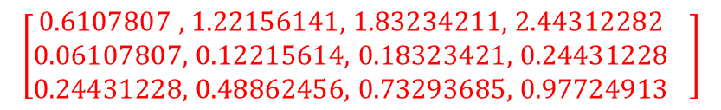
Neural Networks
$$\left[\begin{aligned}\text{0.6107807 , 1.22156141, 1.83234211, 2.44312282} \\ \text{0.06107807, 0.12215614, 0.18323421, 0.24431228} \\ \text{0.24431228, 0.48862456, 0.73293685, 0.97724913} \end{aligned}\right]$$
10km
0.1
0.2
0.9354
Now the final step is a more complex dot product that we want to give us the correct dimensions i.e 4 x 3
0.1
1.335
0.1
0.1
0.1
0.2
0.9354
1.435
1km
0.1
4.840
0.6772
0.1
1.535
0.1
0.1
0.2
0.9354
0.1
0.1
1.635
4
$$xent=−0.1692$$
0.1
0.2
0.9354

Slide 112
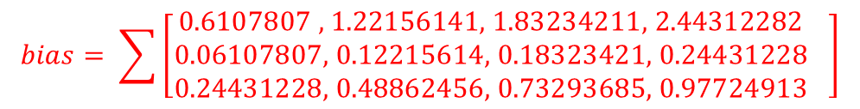
Neural Networks
$$bias= \sum{\left[\begin{aligned}\text{0.6107807 , 1.22156141, 1.83234211, 2.44312282} \\ \text{0.06107807, 0.12215614, 0.18323421, 0.24431228} \\ \text{0.24431228, 0.48862456, 0.73293685, 0.97724913} \end{aligned}\right]}$$
10km
0.1
0.2
0.9354
Again our bias is the sum of all the changes.
0.1
1.335
0.1
0.1
0.1
0.2
0.9354
1.435
1km
0.1
4.840
0.6772
0.1
1.535
0.1
0.1
0.2
0.9354
0.1
0.1
1.635
4
$$xent=−0.1692$$
0.1
0.2
0.9354

Slide 113

Neural Networks
$$bias=9.1617$$
10km
0.1
0.2
0.9354
Again our bias is the sum of all the changes.
0.1
1.335
0.1
0.1
0.1
0.2
0.9354
1.435
1km
0.1
4.840
0.6772
0.1
1.535
0.1
0.1
0.2
0.9354
0.1
0.1
1.635
4
$$xent=−0.1692$$
0.1
0.2
0.9354

Slide 114
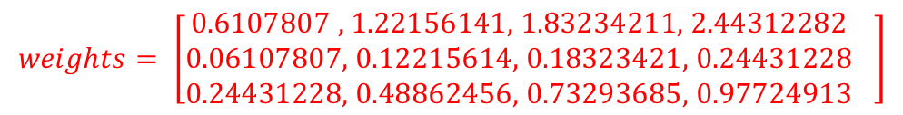

Neural Networks
$$weights= \left[\begin{aligned}\text{0.6107807 , 1.22156141, 1.83234211, 2.44312282} \\ \text{0.06107807, 0.12215614, 0.18323421, 0.24431228} \\ \text{0.24431228, 0.48862456, 0.73293685, 0.97724913} \end{aligned}\right]$$
$$bias=9.1617$$
10km
0.1
0.2
0.9354
Again our bias is the sum of all the changes.
0.1
1.335
0.1
0.1
0.1
0.2
0.9354
1.435
1km
0.1
4.840
0.6772
0.1
1.535
0.1
0.1
0.2
0.9354
0.1
0.1
1.635
4
$$xent=−0.1692$$
0.1
0.2
0.9354

Slide 115
Neural Networks
$$weights= \left[\begin{aligned}\text{0.6107807 , 1.22156141, 1.83234211, 2.44312282} \\ \text{0.06107807, 0.12215614, 0.18323421, 0.24431228} \\ \text{0.24431228, 0.48862456, 0.73293685, 0.97724913} \end{aligned}\right]$$
$$bias=9.1617$$
10km
0.71
0.9354
And again it is important to remember these are the changes so we still have to add them to the current weights.
9.3617
1.335
1.32
1.93
2.54
0.16
9.3617
0.9354
1.435
1km
0.22
4.840
0.6772
0.28
1.535
0.34
0.34
9.3617
0.9354
0.59
0.83
1.635
4
$$xent=−0.1692$$
1.08
0.9354
9.3617

Slide 116
Neural Networks
And there we have it. One full forward and backwards pass of our network which now has new weights and biases after training.
0.71
9.3617
1.335
1.32
1.93
2.54
0.16
9.3617
1.435
0.22
4.840
0.28
1.535
0.34
0.34
9.3617
0.59
0.83
1.635
1.08
9.3617

Slide 117
Neural Networks
This is the principal of neural networks, now imagine if there were 5 possible outputs and 100 inputs with 200 hidden neurons.
0.71
9.3617
1.335
1.32
1.93
2.54
0.16
9.3617
1.435
0.22
4.840
0.28
1.535
0.34
0.34
9.3617
0.59
0.83
1.635
1.08
9.3617

Slide 118
Neural Networks
It still works the same just scaled up.
This was just a very simple taste.
0.71
9.3617
1.335
1.32
1.93
2.54
0.16
9.3617
1.435
0.22
4.840
0.28
1.535
0.34
0.34
9.3617
0.59
0.83
1.635
1.08
9.3617

